Slide 1
FIRST ORDER LOGIC AND PROLOG

Slide 2
Rule Based Expert Systems
The rule-based system in AI bases choices or inferences on established rules.
These laws are frequently expressed in human-friendly language, such as "if X is true, then Y is true," to make them easier for readers to comprehend.
Expert and decision support systems are only two examples of the many applications in which rule-based systems have been employed.

Slide 3
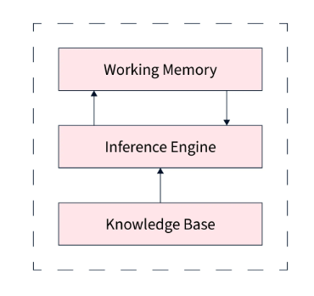
What is a Rule-based System?
A system that relies on a collection of predetermined rules to decide what to do next is known as a rule-based system in AI.
These laws are predicated on several circumstances and deeds. For instance, if a patient has a fever, the doctor may recommend antibiotics because the patient may have an infection.
Expert systems, decision support systems, and chatbots are examples of apps that use rule-based systems

Slide 4
Characteristics of Rule-based Systems in AI
The following are some of the primary traits of the rule-based system in AI:
The rules are written simply for humans to comprehend, making rule-based systems simple to troubleshoot and maintain.
Given a set of inputs, rule-based systems will always create the same output, making them predictable and dependable. This property is known as determinism.
A rule-based system in AI is transparent because the standards are clear and open to human inspection, which makes it simpler to comprehend how the system operates.
A rule-based system in AI is scalable. When scaled up, large quantities of data can be handled by rule-based systems.
Rule-based systems can be modified or updated more easily because the rules can be divided into smaller components.

Slide 5
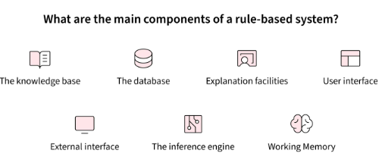
How does a Rule-based System Work?
A rule-based system in AI generates an output by using a collection of inputs and a set of rules.
The system first determines which principles apply to the inputs. If a rule is applicable, the system executes the corresponding steps to generate the output.
If no guideline is applicable, the system might generate a default output or ask the user for more details.

